Slide 1
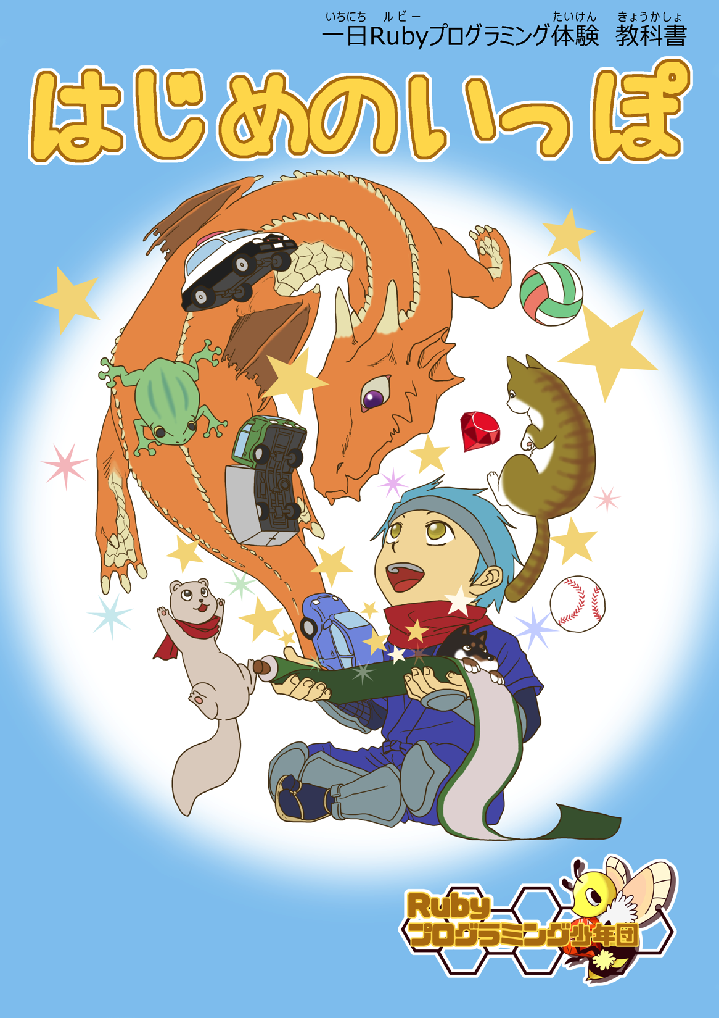
Kids,Ruby,Fun!
小学3年生にも使える、 プログラミング言語Rubyに特化したビジュアルプログラミングエディタ『スモウルビー』の開発と、 Rubyプログラミング少年団によるプログラミング教育関連事業
高尾宏治
Rubyプログラミング少年団
Notes:
Hi, everyone, How are you?
Thank you for attending. This presentation is called “Kids, Ruby, Fun!”.
I’ll discuss our activities with the Ruby Programming Shounendan, especially *Smalruby* which is *a key part* of it.
Here we go!

Slide 2
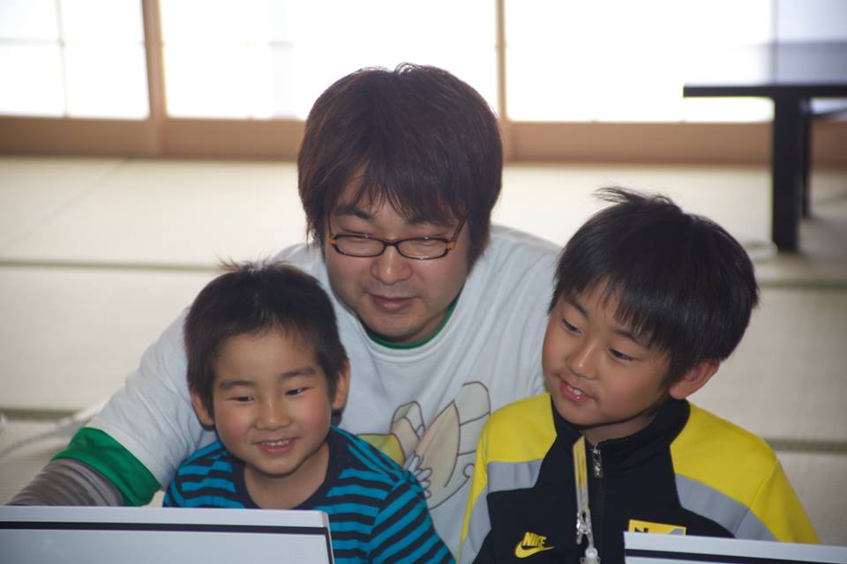
高尾 宏治
CRubyコミッタ (担当：Readlineモジュール)
Rubyプログラミング少年団
Notes:
I’m Kody, Kouji Takao, one of the CRuby commiters, and a leader of the Ruby Programming Shounendan.
Shounendan is a Japanese word. “Shounen” means boys and girls, “Dan” means an organization, so “Ruby Programming Shounendan” means a boys and girls organization for leaning Ruby programming.

Slide 3
高尾 宏治
ネットワーク応用通信研究所
Network Applied Communication Laboratory
コンタクト kouji@smalruby.jp @takaokouji Facebook
Notes:
Also, I’m a research engineer at Network Applied Communication Laboratory, aka NaCl.

Slide 4
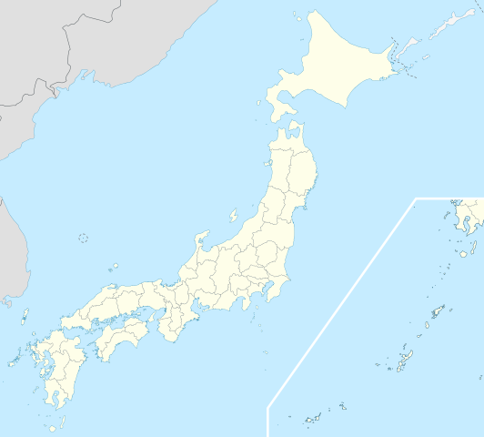
島根県松江市
http://en.wikipedia.org/wiki/File:Japan_location_map_with_side_map_of_the_Ryukyu_Islands.svg : Maximilian Dörrbecker (Chumwa) CC-BY-SA 3.0CC by SA
Notes:
The headquarters of NaCl, is located in Matsue-city, Shimane Prefecture of Japan.
Matsue is a city of about two handled thousand (200,000) people near Hiroshima.

Slide 5
６年前
Notes:
Six (6) years ago,

Slide 6
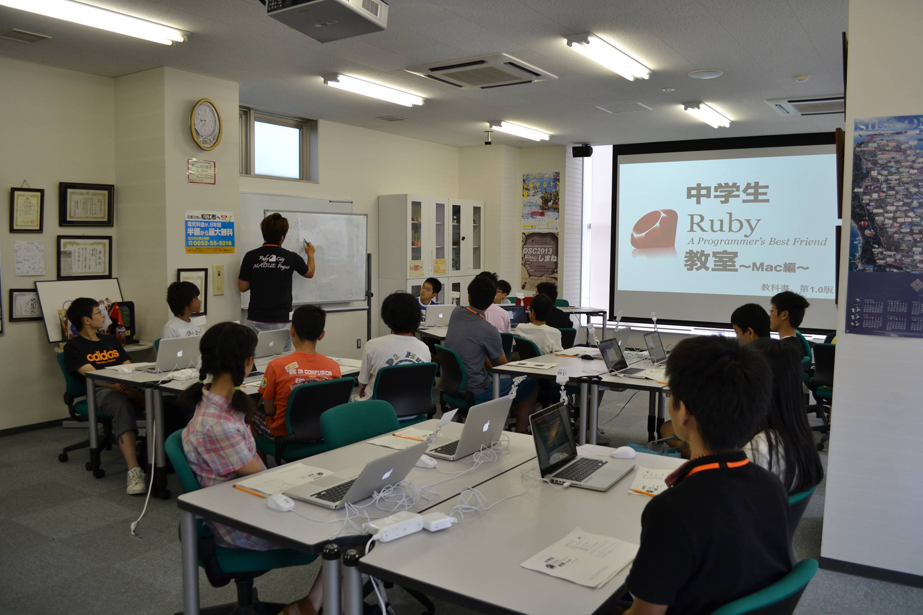
中学生に Rubyを教える
Notes:
I started to teach Ruby programming for junior high school students. In Japan, junior high school is for *three (3) years*.

Slide 7
モチベーション
Notes:
My motivations were
<press>
the Ruby City MATSUE project and
<press>
to teach my son Ruby.

Slide 8
息子にRubyを教える
Rubyが好き
ITの仕事が好き
子どもたちにRubyを教える教材がない
Notes:
My second goal was *my real motivation*.
<press>
I love Ruby
<press>
and IT engineering, so I plan to *teach my son Ruby* to become an IT engineer when he grows up.
However, 6 years ago, I did not have any tools or materials for teaching Ruby to youth, also KidsRuby did not exist at that time.
<press>
So, I decided to make tools and materials for teaching Ruby to youth.

Slide 9
Since then
1% / year
in Matsue-city
Notes:
Since then, I have taught Ruby to over two handled fifty (250) junior high school students. This number is … *low* :-<
<press>
However, *only five thousand five handled (5,500) junior high school students live in Matsue-city, so I teach about *1%* junior high school students in Matsue-city *each year*.
That’s good, right?

Slide 10

Ruby is
AND KIDS?
A Programmer’s
Best Friend
Notes:
Now,
how is Ruby *for programming education*?
As you know, Ruby is *"A Programmer's best friend“*.
Ruby:
* has Simple syntax,
* is Object-oriented and
* has a Garbage collector.
<press>
So I *believe* it’s the same *for kids* who want to start to code.

Slide 11
Problems
Typing
English
Ruby Syntax
Notes:
In these six (6) years teaching ruby in Japan, I’ve encountered these problems:
<press>
First, typing is difficult. Most kids don’t know how to make use of *Symbols*, pressing “shift + ,” is hard!
<press>
Second, *English*… English is hard… ☹ They can understand the roman alphabet, but *basic words* like “if”, “end”, “do” are *still challenging*.
<press>
Third, kids *don’t know* Ruby syntax and standard libraries. So, they aren’t able to work *on their own*,
which leads them to *slow down* the learning experience pace and *be frustrated*. It also increases the need for *more instructors* in the classroom.
Therefore, kids *often quit* before they realize that *programming is fun*.
This is a big problem for me!

Slide 12
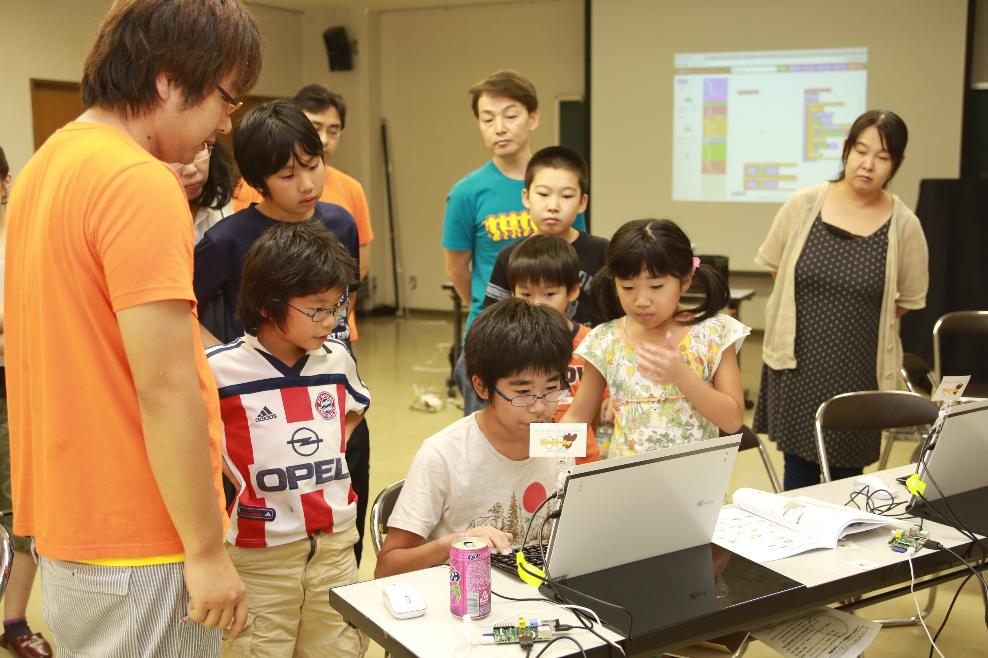
Recently,
Increased
Programming Education
Notes:
You know,
In the last few years,
programming education for elementary and middle school students, has increased world wide.

Slide 13
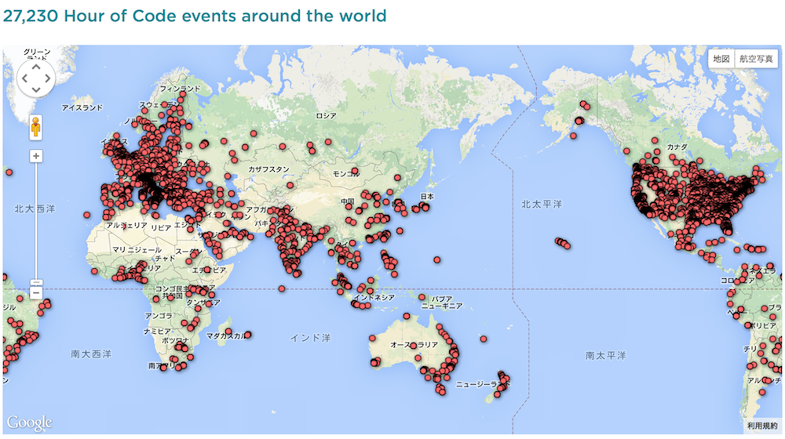
HOUR OF CODE by Code.org
27,230 events around the world
10,000 Teachers
100,000,000 Kids
http://hourofcode.com/
Notes:
One of them is “Hour of Code” project by Code.org.
The project's goal is
<press>
to train over ten thousand(10,000) teachers to effectively learn how to teach others how to code.
<press>
Soon after this initial step is done, it is expected that around one hundred million kids to be taught about programming by these trained professionals.
There are many famous people that believe in this project and donated for this cause, for instance , Mark Zuckerberg, facebook's CEO.

Slide 14
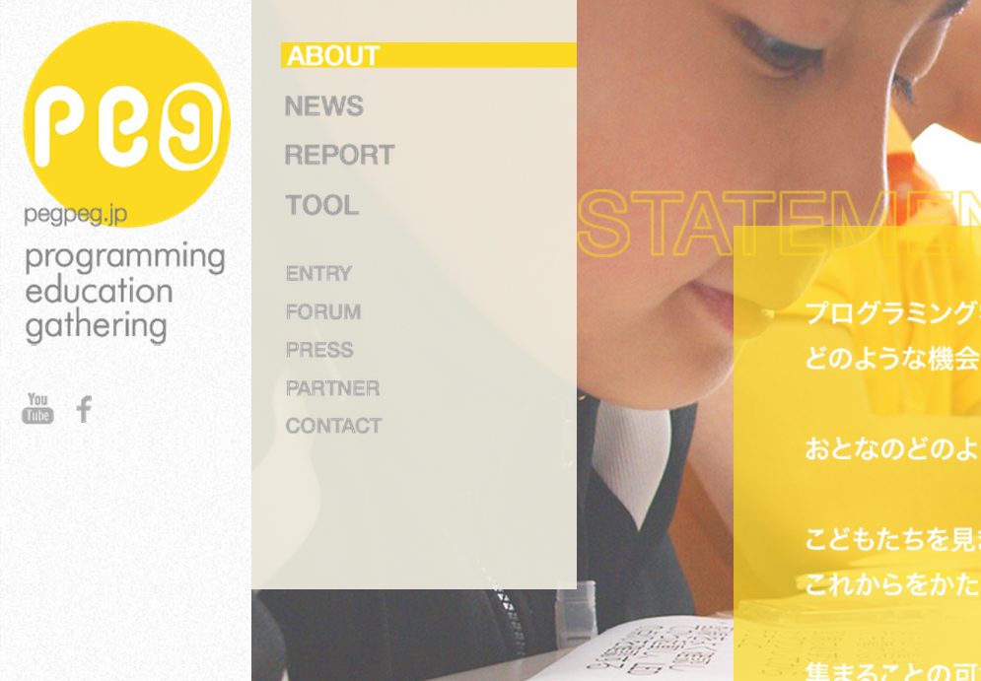

PEG
Joint project of CANVAS and Google
CANVAS hold many workshops for children
Distributed 5,000 Raspberry Pi
http://pegpeg.jp/
Notes:
Especially recently,
PEG which is a project to spread programming education, has become a hot topic.
<press>
PEG is a joint project of CANVAS and Google.
<press>
CANVAS is a Japanese NPO that has held workshops for children. It’s not only programming.
<press>
PEG has held programming workshops and has distributed five thousand (5,000) Raspberry Pi to education business owners in Japan.

Slide 15
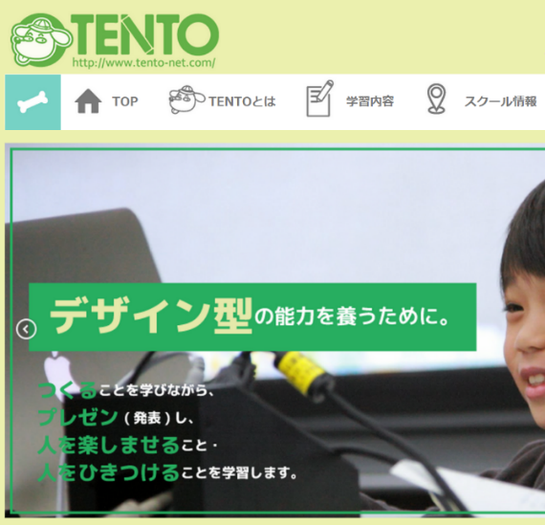

TENTO
Life is Tech!
Individualized
instruction
Boot camping
http://www.tento-net.com/
http://life-is-tech.com/
Notes:
In addition, “TENTO” manages individualized instruction. “Life is Tech!” manages about five days boot camping and weekly school for programming.
“TENTO” and “Life is Tech!” receive a パティシィペーション (participation) fee or tuition, I just interesting is that they manages programming school as business.
Other than those discussed here, workshop of a variety of programming education has been held, programming education for youth has increased in Japan as well as overseas.

Slide 16
Why many kids programming workshops are held?
Great tools and materials!
Notes:
By the way,
do you think that why many kids programming workshops are held recently?
<press>
I believe that we have great tools and materials for teaching programming to youth.

Slide 17
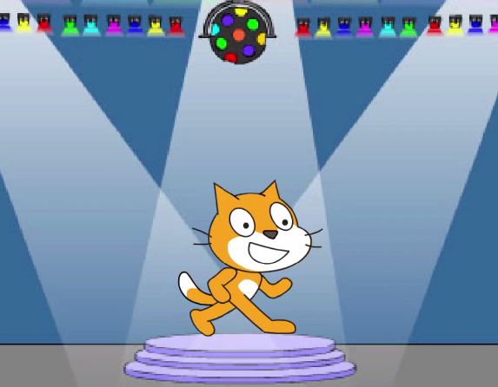
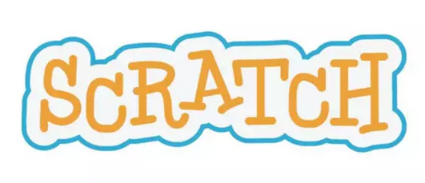
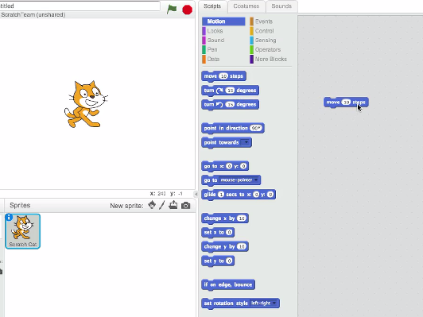

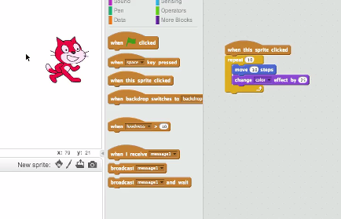

by MIT Media Lab
http://scratch.mit.edu/
http://vimeo.com/65583694
Notes:
Yes, it’s “Scratch”. “Scratch” is most famous programming education tool, right?
Scratch is a visual programming language and tool. MIT has developed it. It is used in the following classes and workshops of many programming. Scratch’s users are more than two million (2,000,000) worldwide.
In Japan, it has been most often used in the workshop of programming education in elementary and junior high school students.

Slide 18
Blocks
= Instructions
Combination
of blocks
= Program
Notes:
In Scratch,
<press>
instructions are blocks,
<press>
and combination of blocks describe your program,
so you are easy to find instruction and make program.

Slide 19
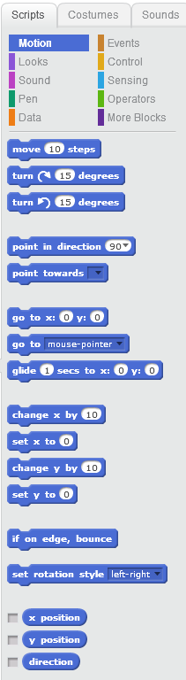
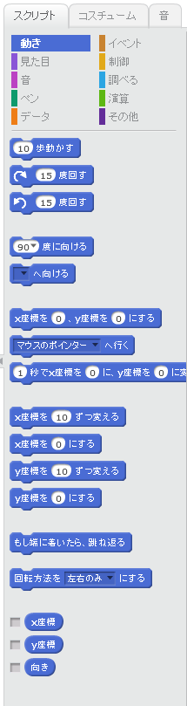
Internationalization
English
Japanese
Notes:
Also Scratch supports internationalization, so Japanese kids are easy to understand everything.

Slide 20
Easy to run
Press
Run
Notes:
If you want to run your program,
<press>
you only press the green flag on screen then your program starts to run.

Slide 21
Problems
Typing
English
Ruby syntax
➡Blocks
➡ Internationalization
➡ Combination of blocks
Notes:
So I believed that Scratch features will solve my problems.
<press>
Typing, instruction Blocks
<press>
English, internationalization
<press>
Ruby syntax, combination of blocks

Slide 22

Ruby + Scratch
Hi,
I’m Hatti!
Smalruby
(smɔ́ːrúːbi)
Notes:
So, we have developed Smalruby.

Slide 23
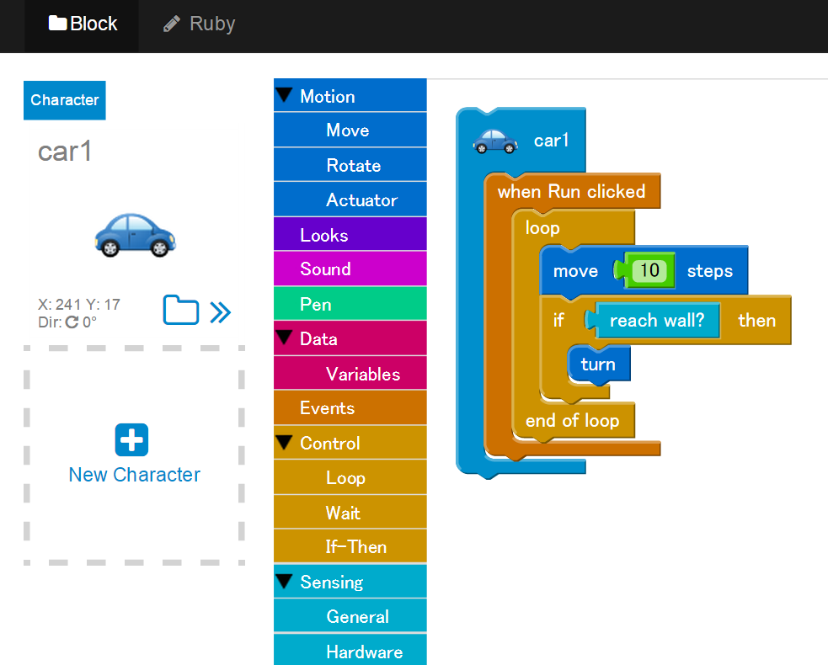
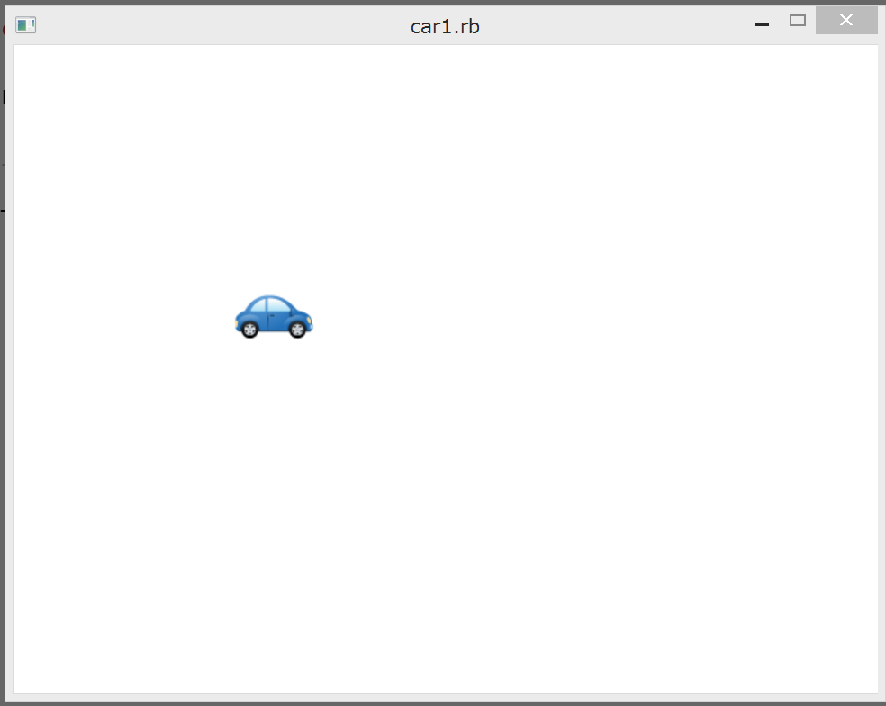
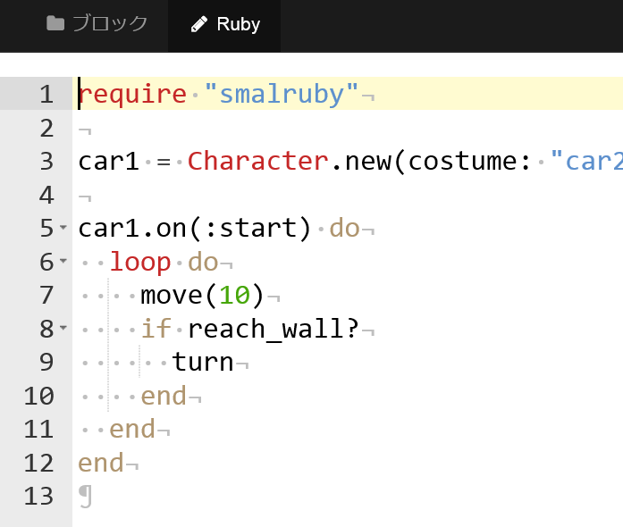
Demo
Notes:
Right now, I will show what is Smalruby.
(Highlight a character, then press the Enter button, “Ruby” button to place the instruction block, run the ruby in the background, the character will move.)
This is Smalruby.

Slide 24
Smalruby
(smɔ́ːrúːbi)
GitHub:
smalruby/smalruby-editor
Notes:
Smalruby:

Slide 25
Scratch Features
Instruction Blocks
Characters and Stages
Easy to Run
Notes:
Just like Scratch, Smalruby makes use of instructional blocks. By making use of characters and "stages", these blocks are very "easy to run".
Things like creating, updating and loading a file are very simple!

Slide 26
Instruction Block
Ruby
Notes:
Smalruby can convert instruction blocks to Ruby code.

Slide 27

Ruby
Instruction Block
Notes:
Smalruby is also able to transform Ruby code to Instruction blocks !
This 2 way communication is an interesting add for a visual programming editor. I believe this is a very special feature, and it was implemented because of some interesting experiences that we’ve had.

Slide 28
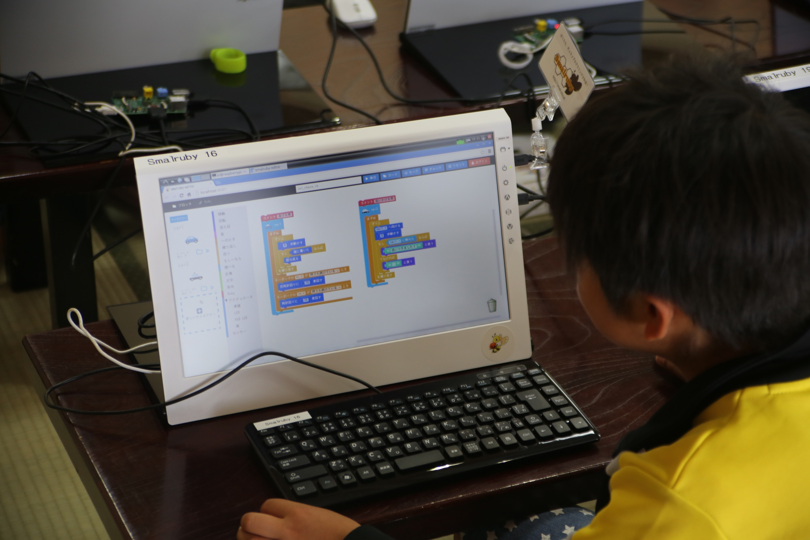
KIDS WANTED TO CODE DIRECTLY!
Notes:
While I was teaching programming for kids using an earlier version of Smalruby, a very interesting situation constantly happened.
Some kids would want to take the programming experience one step further, they wanted to implement more features to their programs. Create programs like … how to find a prime number! Or making a new programming language ( Was that “matz” kid ? haha).
The instruction blocks were not enough and they wanted more !
<press>
They wanted to enter the code directly !
Because of that, I realized that kids wished to code.
So I thought that by making Smalruby able to make use of both code and instruction blocks while linking the information, would be a great add for these kids experience by allowing them to transition more naturally to “hard coding” in their own pace and slowly get introduced to the ruby syntax and standard library.

Slide 29



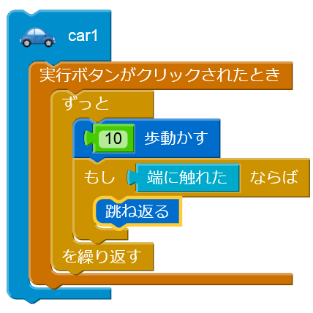
Vim Icon : http://www.vim.org/index.php
Emacs icon : http://ochiailab.blogspot.jp/2013/04/powerlineelemacs.html
Sublime Text icon : http://blog.livedoor.jp/nonprofessional/archives/1004031653.html
Notes:
Once these kids have learned the fundamentals of programming using instruction blocks.
<press>
I plan to introduce them as soon as possible to coding and also helping them with handy programmer things.
Like picking an Editor !

Slide 30
Now
Notes:
Okay,
now that we have Smalruby, I believe I’ll have an easier for teaching them the coding fundamentals.

Slide 31
The Ruby
Programming Shounendan
Notes:
Another topic.
Smalruby is designed for students that are over eight (8) years old. With that in mind, combined with my passion of preparing these “future programmers”, I’ve decided to create the Ruby Programming Shounendan.
The Ruby Programming Shounendan is an NPO for kids, that has been working under the banner of:

Slide 32
“Promoting the joy of programming to many kids. “
“Building internet safety awareness for kids through programming!”
Notes:
“Promoting the joy of programming to many kids. “ and
<press>
“Building internet safety awareness for kids through programming!“.

Slide 33
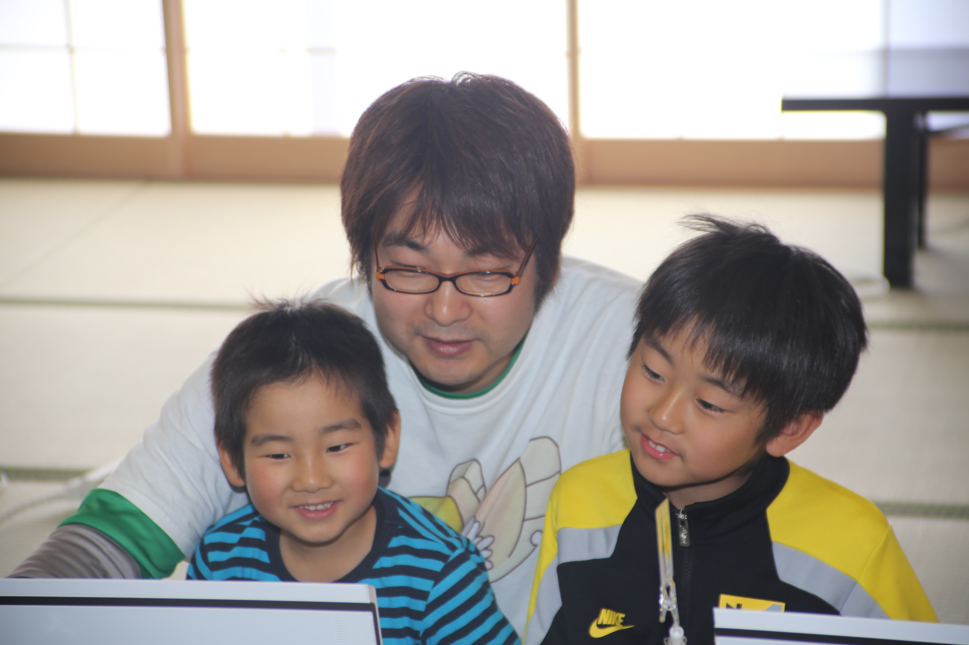
Ruby programming events for kids
and parents
Introducing Ruby,
once a month
Notes:
We have numerous activities. On the third Sunday of each month, we hold a ruby programming event for kids and parents.

Slide 34
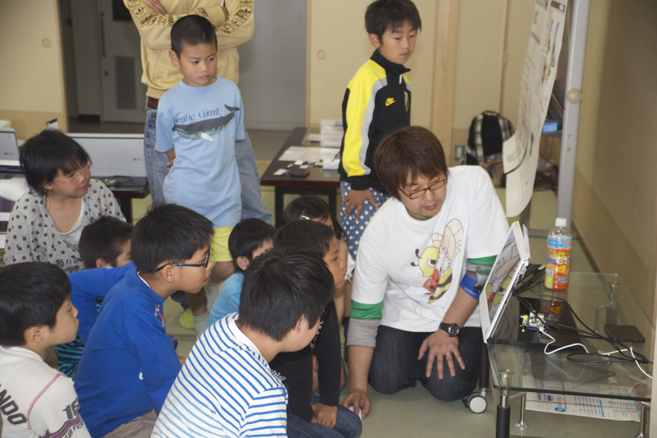
Notes:
These are photos from the event.
Right now I’m teaching them how to make a “car chase” game.

Slide 35
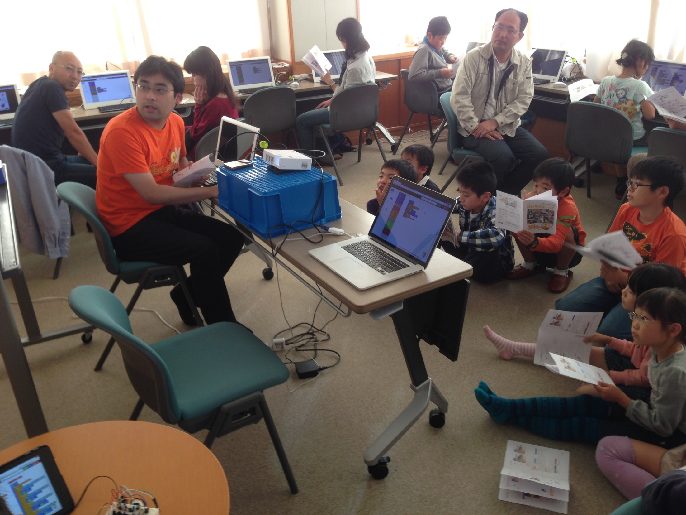
Notes:
This one is from a recent event.

Slide 36
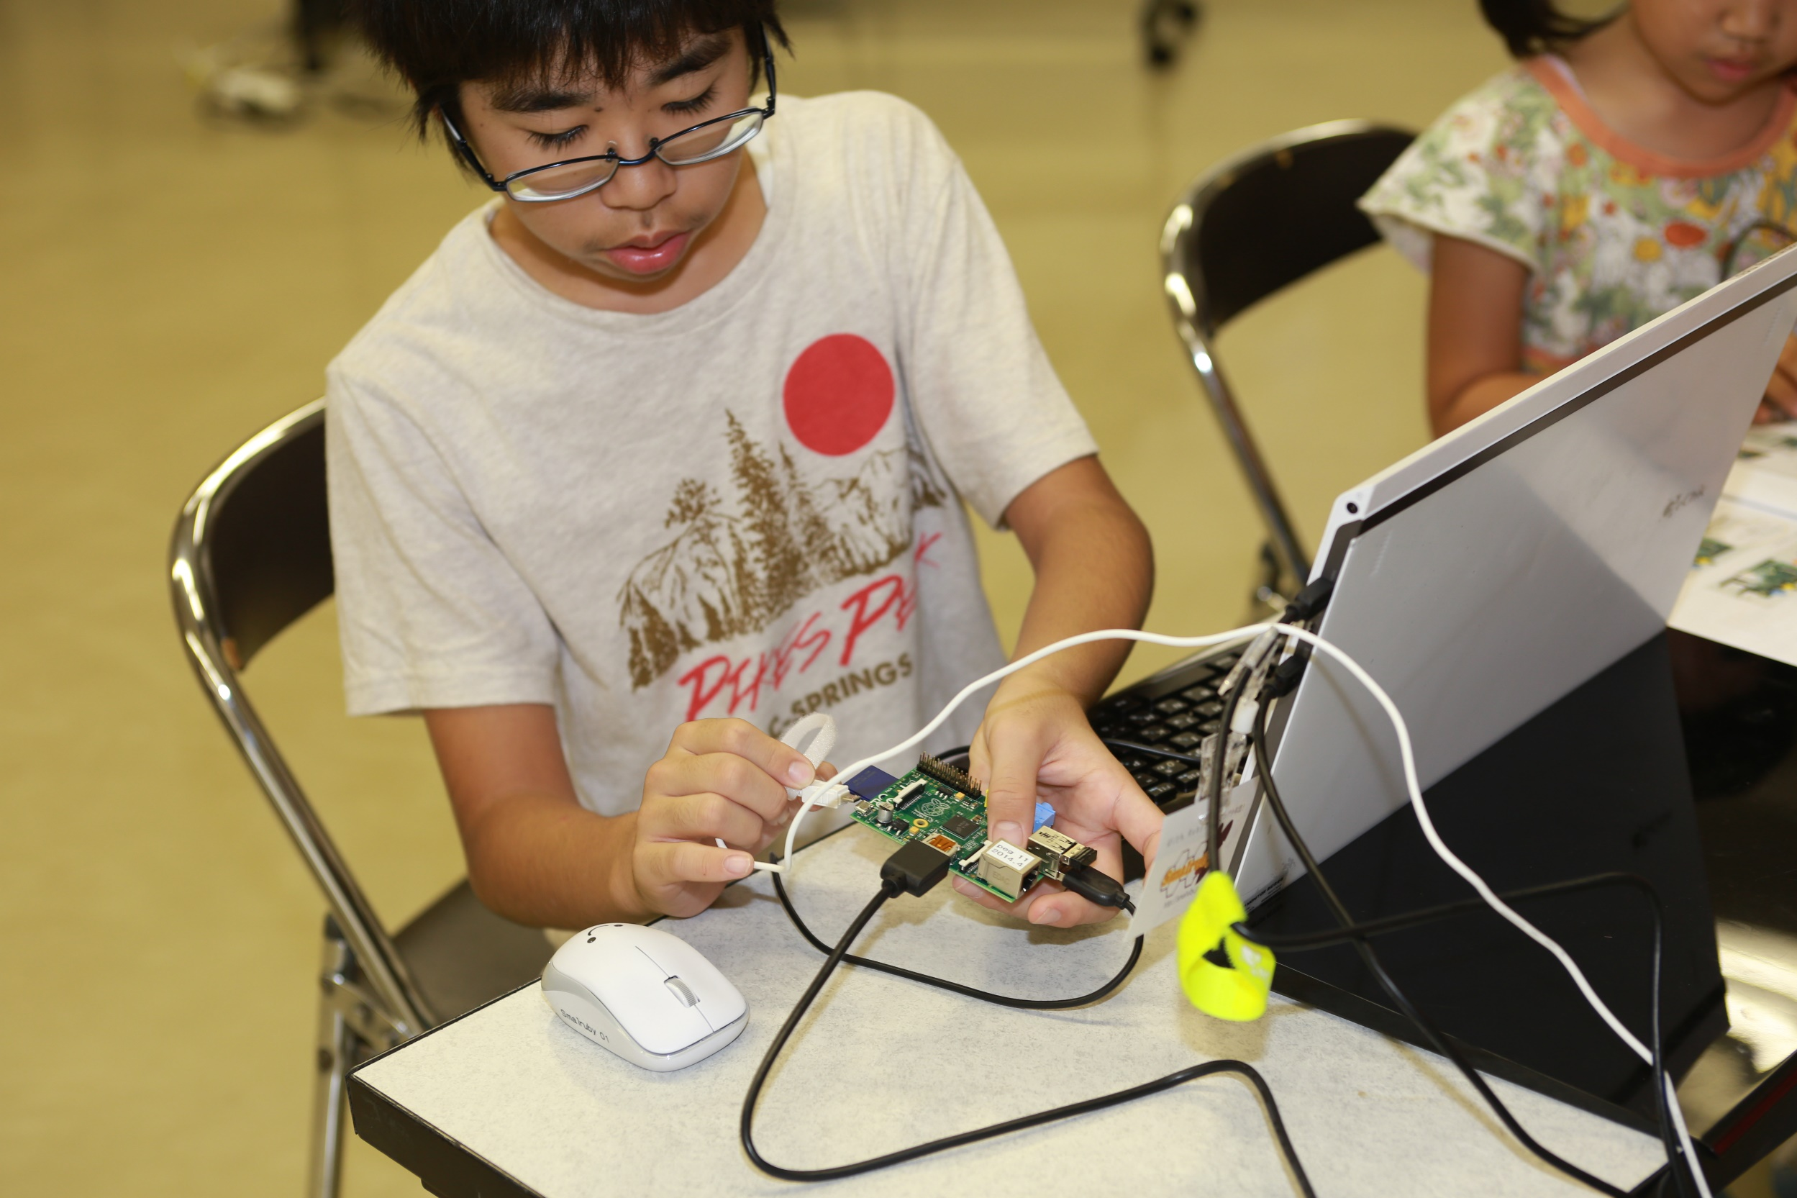
Notes:
That’s a Raspberry Pi.
The students are also in charge of assembling the components by themselves.

Slide 37
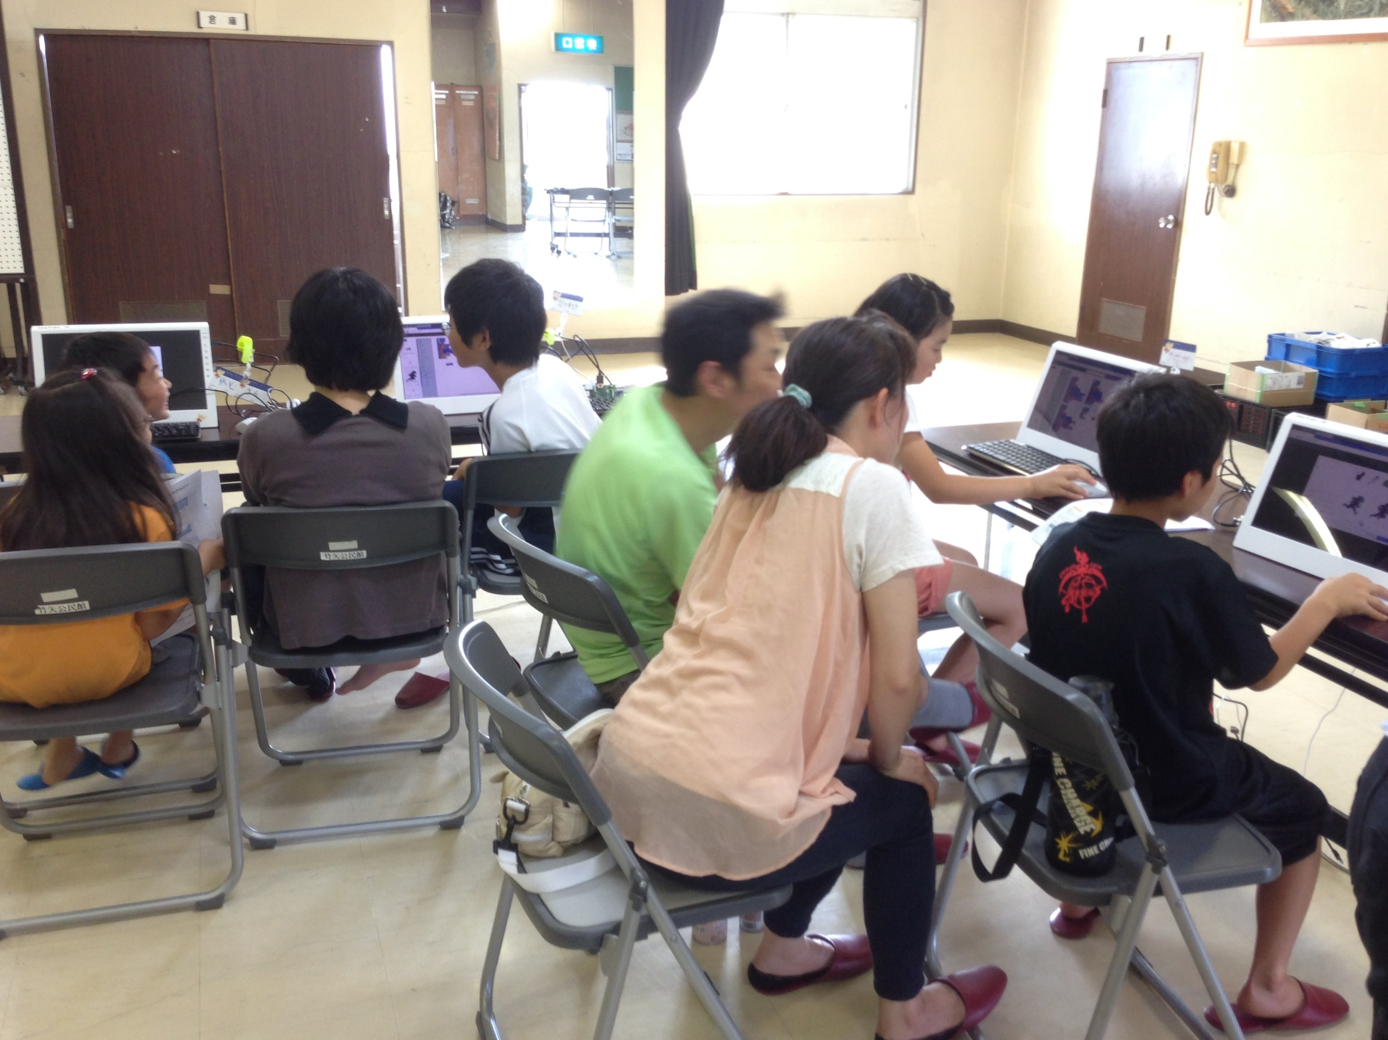
Notes:
Here are some parents supporting their kids.
They are always so willing to help their kids and that’s great !
But sometimes, we ask them to hold this impulse as hard as they can, so the kids can experiment a little and find the answers by their own effort.

Slide 38
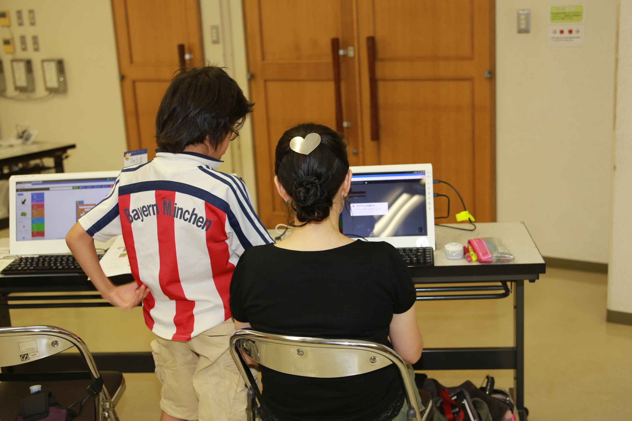
Notes:
Sometimes, the inverse process also happens. :D

Slide 39
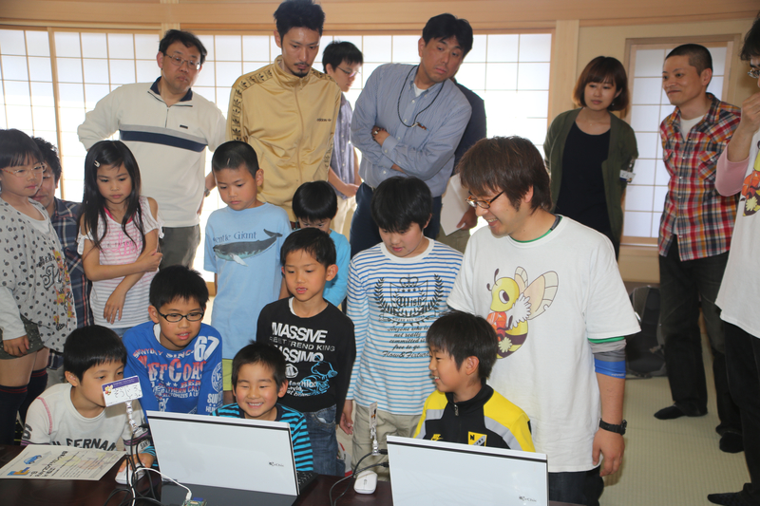
Notes:
Whenever an interesting program is created in these events, we gather everyone and make a short explanation of what’s happening.

Slide 40
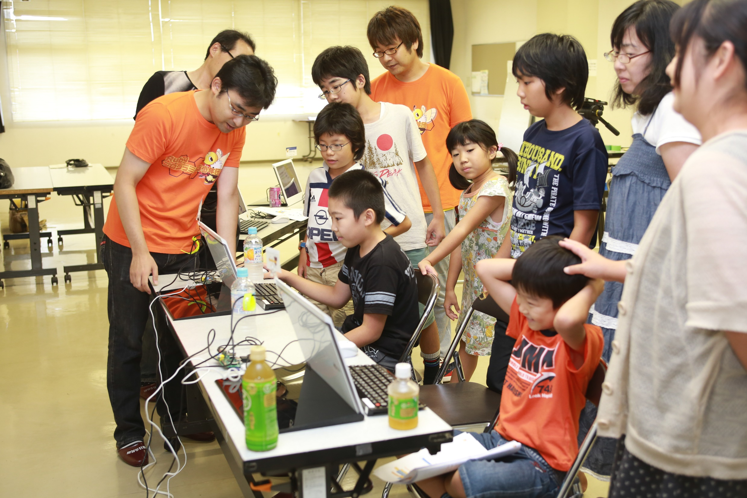
Notes:
It’s very fun !

Slide 41
CoderDojo Matsue
https://coderdojo.com
Free Ruby computer programming club for Kids,
once a month
Notes:
Also, we hold the CoderDojo Matsue on the fourth Saturday of each month.
The CoderDojo is the global network of free computer programming clubs for young people. It is managed by volunteers. The CoderDojo doesn’t specify which programming language or tools to use, so we are surely using Ruby.

Slide 42
Ruby Programming Shounendan
Team
≒
Tourna-ment
Coach
Youth Sports Club
Notes:
In the future, we will be like a youth sports club for soccer or baseball:
* There will be many teams
* Volunteer coaches
* With regional, prefectural (which is like a state) and national tournaments
We plan to make such an organization.

Slide 43
Conclusion
Teaching Ruby Motivations
TEACH MY SON RUBY
Smalruby
For over 8 years old
Ruby Programming Shounendan
Learning Ruby Organization for Boys & Girls
Notes:
Conclusion, in this presentation,
<press>
* I started to teach junior high school students Ruby. My motivations were Ruby City MATSUE Project and to teach my son Ruby.
<press>
* I have created Smalruby which is designed for over 8 years old and like Scratch.
<press>
* I started the Ruby Programming Shounendan which is a learning Ruby organization for boys & girls.
I explained.

Slide 44
I believe that people should focus on creating tools to help everyone.
Notes:
I believe that people should focus on creating tools to help everyone.

Slide 45
“Facing problems and looking for the answer that will solve them”
is a very important.
Notes:
Constantly facing problems and looking for the answer that will solve them, is a very important aspect of our jobs.

Slide 46
I sympathize with everyone here and …
Notes:
I sympathize with everyone here and …

Slide 47
I’m glad that we are all somehow involved with OSS development.
Notes:
I’m glad that we are all somehow involved with open source software development.

Slide 48
Ruby is
AND KIDS!
A Programmer’s
Best Friend
Notes:
Ruby is a powerful tool, a great answer for our problems.
<press>
So we have to try and do our best in order to provide these future kids, these future programmers, the best tool that we can offer and let them enjoy programming as much as we do.
And hopefully, in the future, they will do the same for their own kids.

Slide 49

THANK YOU
Smalruby (smɔ́ːrúːbi)
GitHub: smalruby/smalruby-editor
Email: contact@smalruby.jp
Twitter: @smalruby
Notes:
Thank you very much.
Now, I should say that “Do you have any questions?”, but unfortunately I can’t answer right now, because of my English, listening is no good, speaking is so bad.
So if you have a question, you could talk one to one after this presentation, sorry.
Thank you so much.

